Slide 1
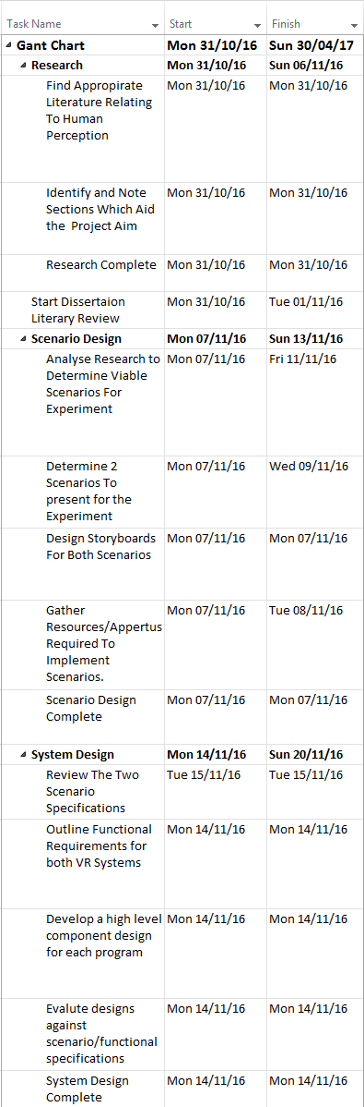

Slide 2
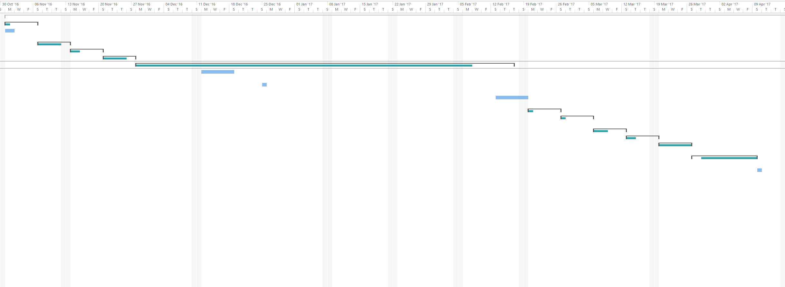
Research
Scenario Design
System Design
Experiment Design
System Development
Mobile Computing Focus
Christmas Day
Start of dissertation introduction
Testing
System Revisions
Experiment
Data Analysis
Dissertation Conclusion
Evaluate Dissertation Draft
Output Final Dissertation Piece

